Slide 1

PYTHON INTRODUCTION AND INSTALLATION Shoaib & Jagdish

Slide 2
Agenda
Python Introduction
Python Features
Who uses python
Python Installation
Setting Python Environment
Integrated Development Environment
Python Syntax
First Python Code

Slide 3
Python Introduction
Python is Interpreted
Python is Interactive
Python is Object-Oriented
Python is a Beginner's Language

Slide 4
Who uses Python?
Data Science
Automation
IOT
Web development
Machine Learning
Arrays of object references

Slide 5
Python Features
Easy-to-learn, read and maintain.
Everything is object
A broad standard library
Portable
Extendable
Databases
GUI Programming
Scalable
Arrays of object references

Slide 6
Python Installation
Windows:
GUI Installation
Run exe with “Run As Administrator”
Silent Installation
<python exe> /quiet InstallAllUsers=1 PrependPath=1
msiexec /i <python msi> TARGETDIR:C:\<python_dir> ALLUSERS=1
https://docs.python.org/3/using/windows.html
Linux:
$sudo apt-get install python3

Slide 7
Setting Python Environment
Windows :
How to identify if environment variable is set or not?
How to set Environment variable?
Python Official Website : http://www.python.org/
Python Documentation Website : www.python.org/doc/

Slide 8
Integrated Development Environment(IDE):
IDLE:
Default python shell
Other Editors:
Notepad++
Sublime
PyCharm
Eclipse

Slide 9
Python Syntax
Indentation
if condition:
Perform some task
else:
Perform another task
Comments
# This is comment
print()
print(“HELLO WORLD”) -> 3.x
print “HELLO WORLD” -> 2.x
Running python
- From python shell
- From command prompt
Arrays of object references

Slide 10
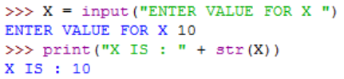
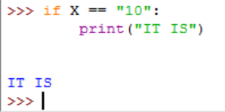
First Python Code with idle
Arrays of object references

Slide 11
Thank you

